Slide 1
Curated For You By You
Team : Cache Me If You Can

Slide 2
Agenda
Team Member Roles and Responsibilities **
Improvements from Feedback
Project Description **
Team Working Agreement**
Personas
MVP
Algorithms
Rest API/Examples
Technologies
Diagrams
Product Backlog
Sprint 2 Backlog
Burndown Chart
User Stories / Test Cases
Project Schedule
Retrospective
AI Disclosure
Github Link

Slide 3
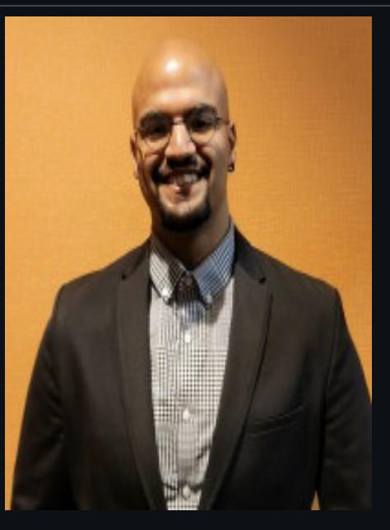
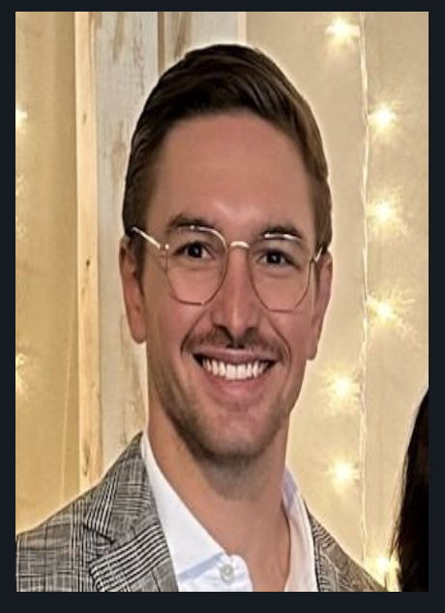
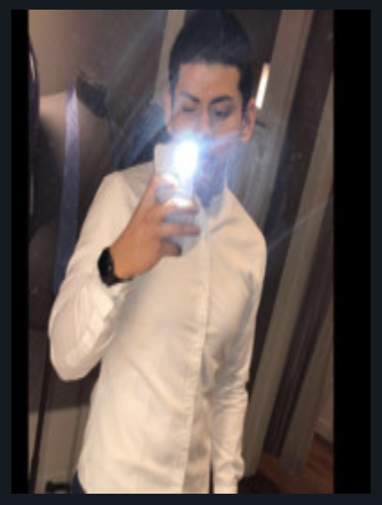
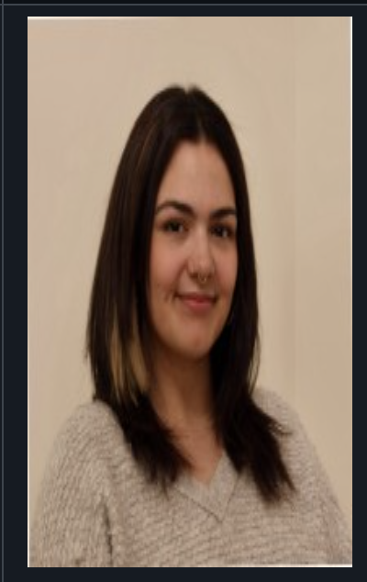
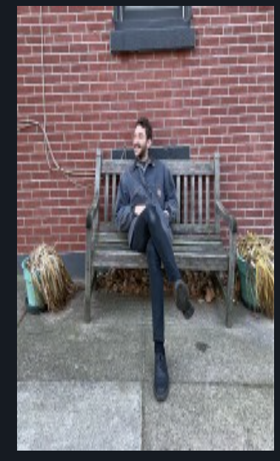
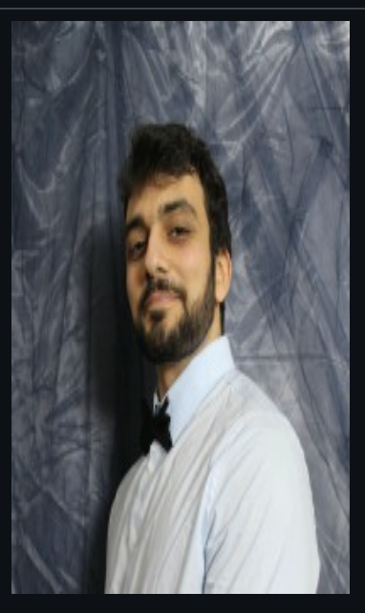
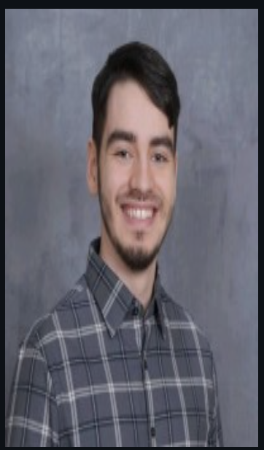
Team Members
Emmet Allen- Scrum Master / Systems Architect
Ben Smith - Backend Dev / Integrations
Brian Moran - Full Stack Dev
Front End Dev Lead
Pete Adams - Back End Lead / Data Team
Christos Markakis - Data Team / Full Stack Dev
Jalen Gill - Front End Dev / Integrations

Slide 4
Improvements from Feedback
Reviewed peer and instructor feedback on project presentation and group wiki page.
Added relevant photos throughout the slideshow more specifically the Team Member page.
Incorporated links into the wiki page to meet syllabus standard.
Added download links for current sprint and previous ones
Adjusted agenda slides to be accurate
User stories
Burndown chart
Test cases

Slide 5
Project Description
Curated By You, For You
Curated By You, For You is a web application that helps people discover music and artists based on location.
For: musicians, fans, and music industry professionals
Who: want to be discovered, discover others, and stay connected with trends in local music scenes
What It Does Curated By You, For You searches for information about local artists and organizes it by genre and location, so users can make meaningful local discoveries.
Benefit Outcomes By using this app, people will become more knowledgeable about local music scenes, discover new bands they enjoy, and help smaller musicians grow larger fanbases.

Slide 6
Team Working Agreement
Agreed to meet twice a week Tuesday @ 6:00PM EST
Pairing is necessary to work on a story
If one person in pair is unavailable the other person in the pair is expected to pick up the work
Pairs switch for either each story or each sprint depending on need for expertise if necessary
Stories will be groomed and pointed before opening a sprint
Stories need a kickoff ceremony before work is started on them consisting of 1 or 2 other members

Slide 7
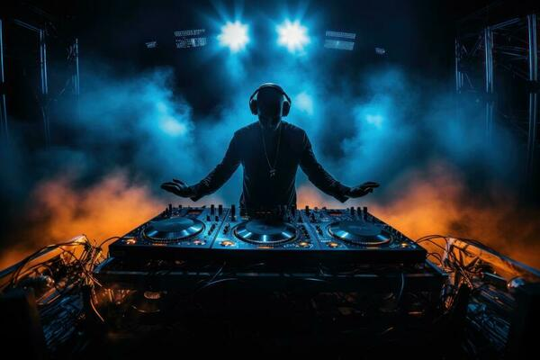
Primary User : DJ Two Tone
Age, 23 Location : New York Occupation: DJ
DJ Two Tone is a local DJ who performs at clubs and parties. While he often mixes popular, well-known tracks into his sets, he’s now looking to incorporate more local cultural music genres to create unique experiences that celebrate the community and connect audiences with the sounds of their own scene.
Issue: Difficulty accessing and integrating unfamiliar cultural music genres—such as Jakarta folk—into performance sets, requiring extensive independent research through scattered sources like record stores, forums, and music databases.
Solution: The platform enables DJs and creators to easily discover and explore local and niche genres by searching specific locations and styles (e.g., Jakarta + Folk Music), instantly connecting them with relevant artists, bands, and tracks to blend seamlessly with their own sets.

Slide 8
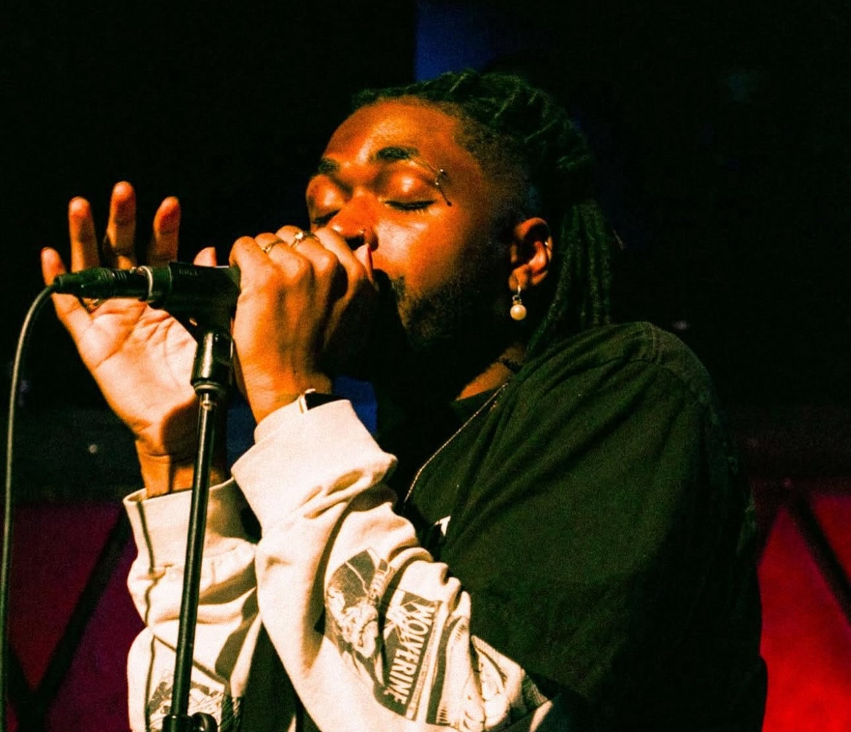
Primary User 2 : Tobi
Age, 29 Location : West Nyack, NY Occupation: Musician
Tobi is a musician looking for his big break into the music industry. He plans on starting in the local scene to build his experience and connections in the industry.
Issue: Music creators face barriers in networking, collaboration, and expanding their creative expertise, limiting growth and visibility.
Solution: Our platform empowers creators by fostering meaningful connections, driving community-driven promotion, and offering tools and resources to continuously expand their skill set.

Slide 9
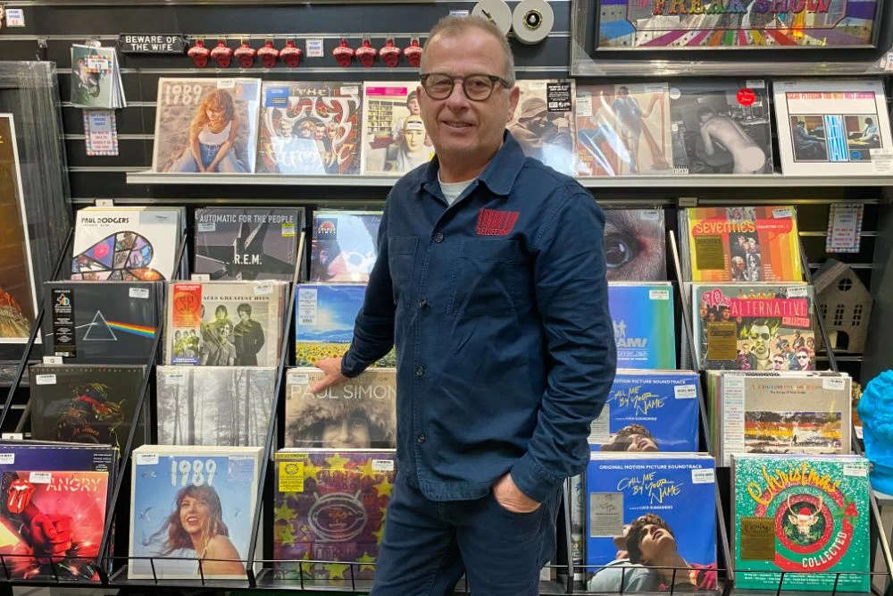
Primary User 3: Glenn
Age, 58 Location : Chattanooga, TN Occupation: Store Manager
Glenn is a store manager that often listens to music in his spare time. He uses apps like Spotify and Apple Music to listen to his preferred music and popular music of today. He wants to immerse himself in new music by discovering new artists locally.
Issue: As a music fan, it can be hard to discover new local performers beyond the big-name acts. Relying on word of mouth or chance encounters often means missing out on fresh talent, especially younger or emerging artists who aren’t promoted widely.
Solution: The platform makes it easy for fans to discover new and local artists tailored to their tastes. By combining personal preferences with location-based recommendations, fans can explore performers they might not otherwise find—helping them connect with fresh music while supporting their local scene.

Slide 10
MVP Feature Prioritization
Feature Name: Location and Genre Based Search
Purpose: Searching Capabilities for Music Artist
User story: As a User, I want to search for artists using a specific location and music genre, so that when I complete the search, I’m provided with a list of artists who are from that location and perform that genre.
Feature Name: Artist Music Listing
Purpose: Provide Artist Music Collection
User story: As a User, when I search an artist using the application, I want to be able to click on an artist, so that I can see their discography

Slide 11
Algorithms:
CM
Entity Resolution / Deduplication: cleaning and removing dupes from our corpus of data
Hybrid Ranking (RRF): merging tables of similar genres on location proximity and popularity
Inverted Index: classic search engine implementation, used to search for band name, genre, location, and/or description

Slide 12
Backend REST API
The heart of the backend is a REST API that’s queryable through HTTP GET requests. Data is accessed from our local repository of artists and then transformed into a JSON payload.
We’ve expanded the dataset and endpoints considerably since Sprint 1.
/ - (root that returns the current API spec and version) /artists /artists/{name} /artists/{name}/description /artists/{name}/image /artists/{name}/albums /artists/genre /artists/city /albums{title}/description

Slide 13
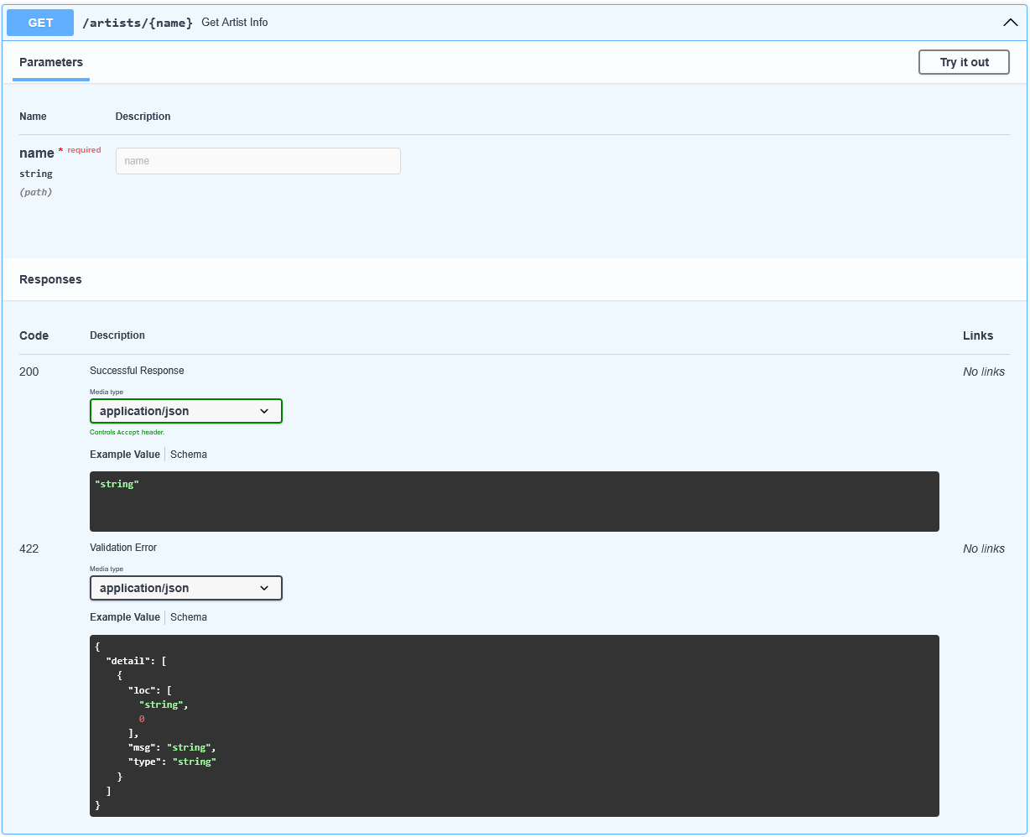
API Request Example

Slide 14
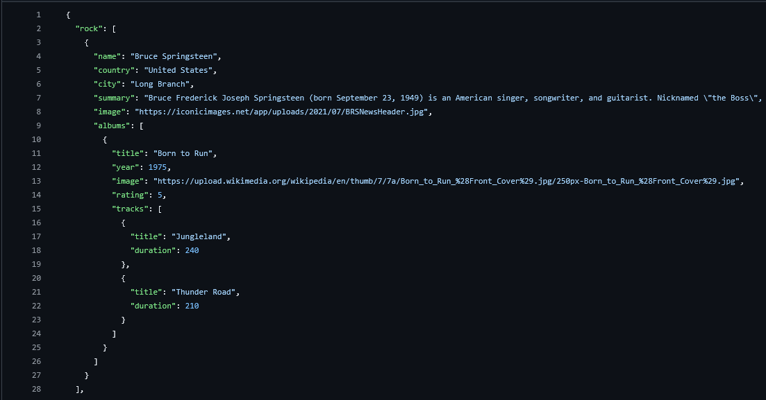
Updated Dataset Example

Slide 15
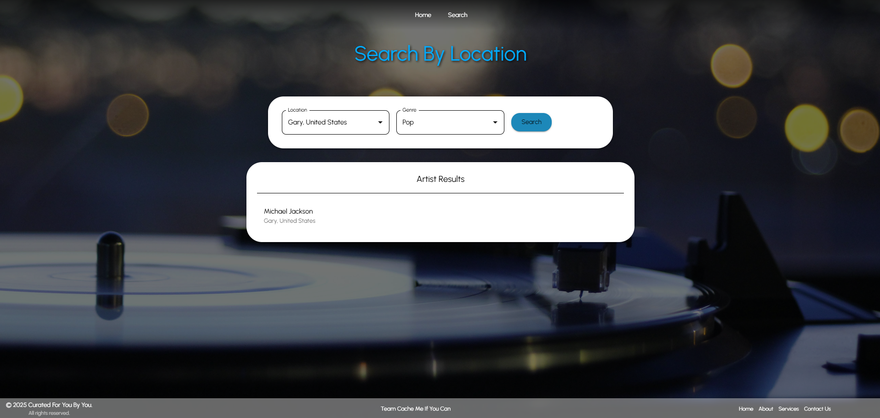
Frontend Search
The search page has been updated with a new layout, allowing for search results to be focused more.

Slide 16
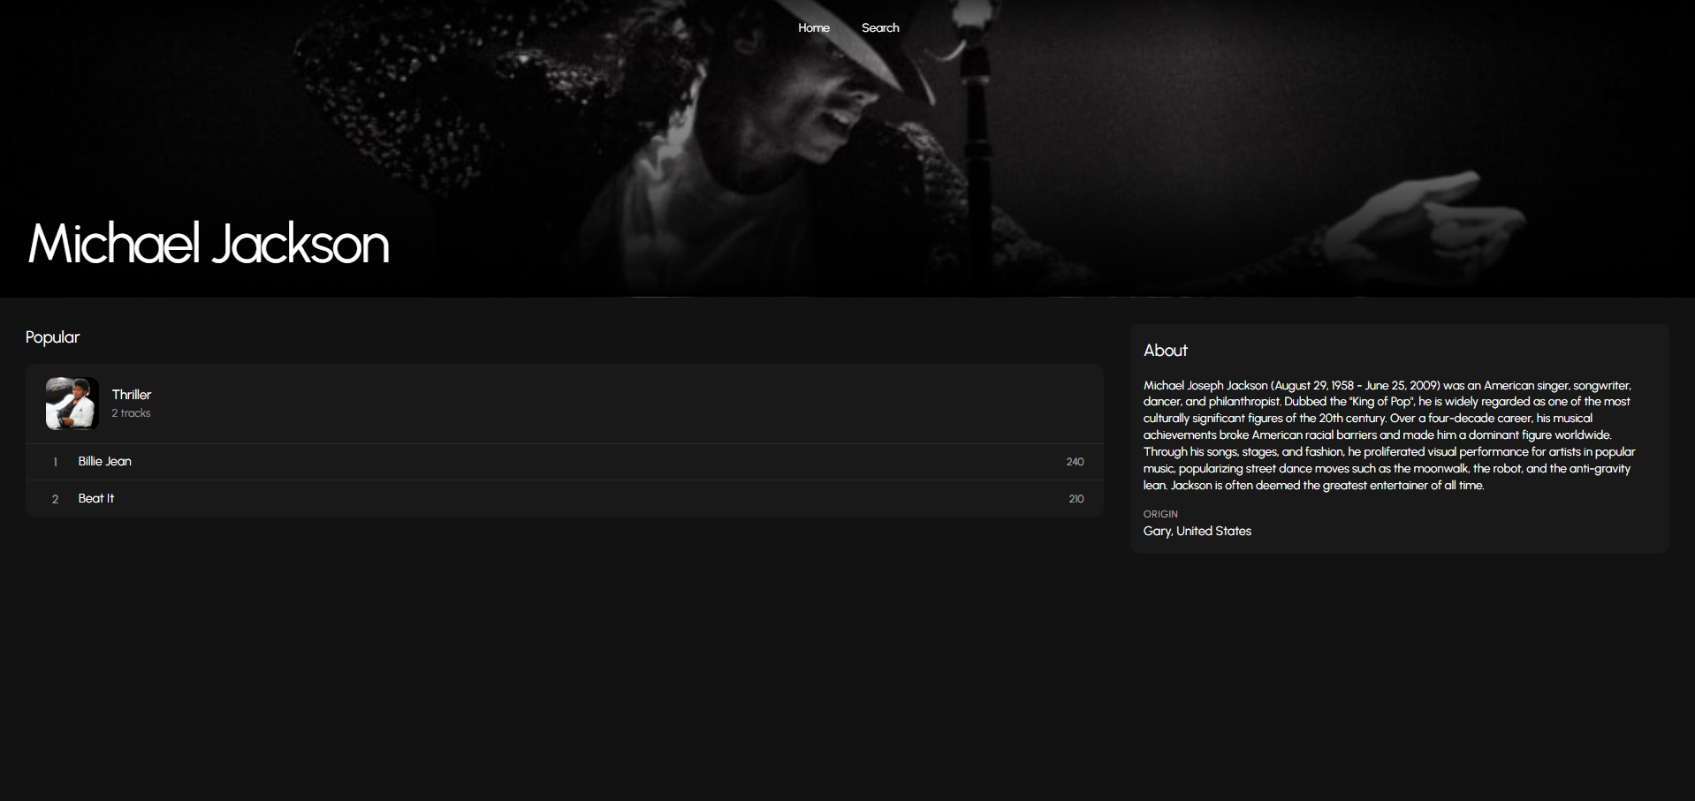
Artist Page
After clicking an artist, the user is taken to a details page that shows more information about the artist.

Slide 17







Technical Implementation
Platform / Technology:
Backend- Python, FastAPI, uvicorn, AWS
Frontend- React, TypeScript, Material.UI (CSS)
3rd Party APIs : Spotify API, Music Brainz API, EveryNoise.com

Slide 18
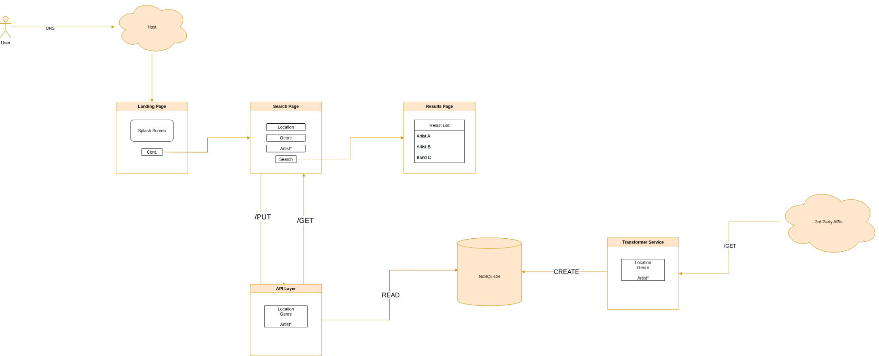
Architecture Diagram

Slide 19
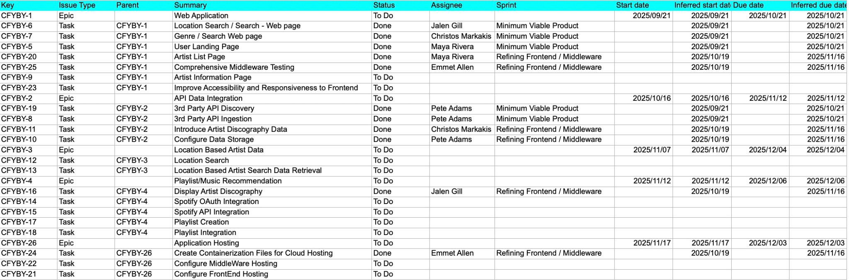
Product Backlog

Slide 20
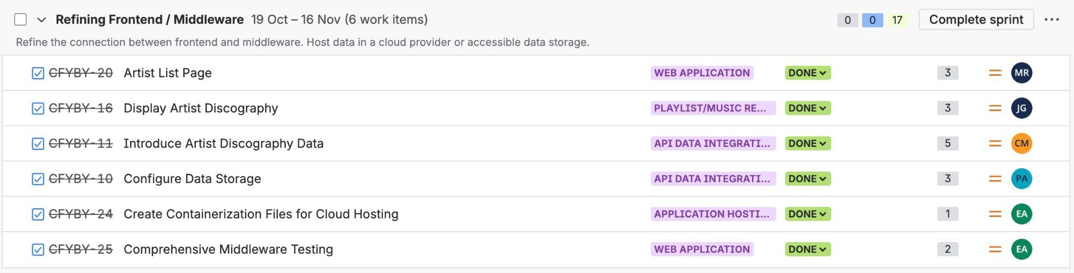
Sprint 2 Backlog
These were the stories completed in Sprint 2. Each story is estimated using story points, which are reflected in the number column.
Story points are a measurement used within Agile to describe the complexity of a given task
For example, a task can be given either a fibonacci number (1,2,3,5) or T-shirt sizes (S,M,L,XL)
It's used to ensure that the team members know what the task may entail before taking up the story or feature

Slide 21
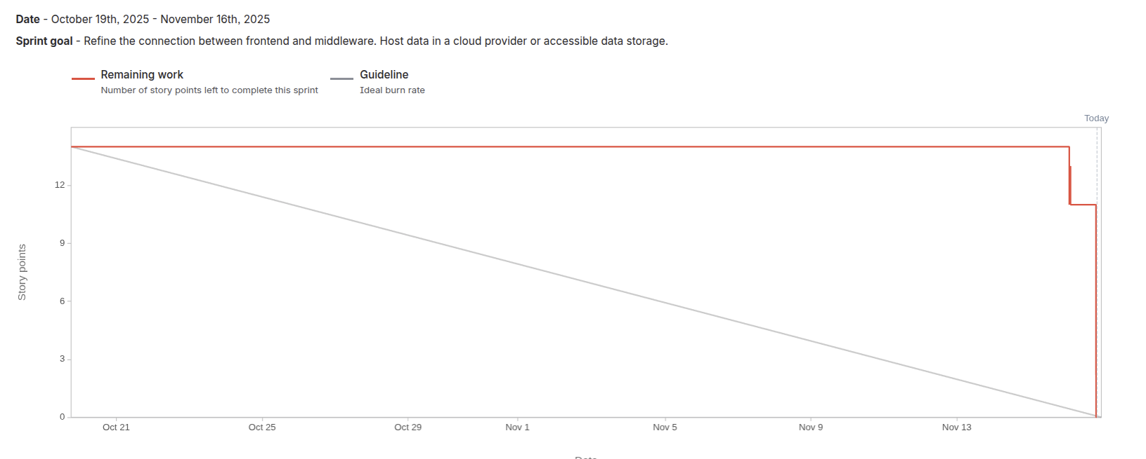
Burndown Chart

Slide 22
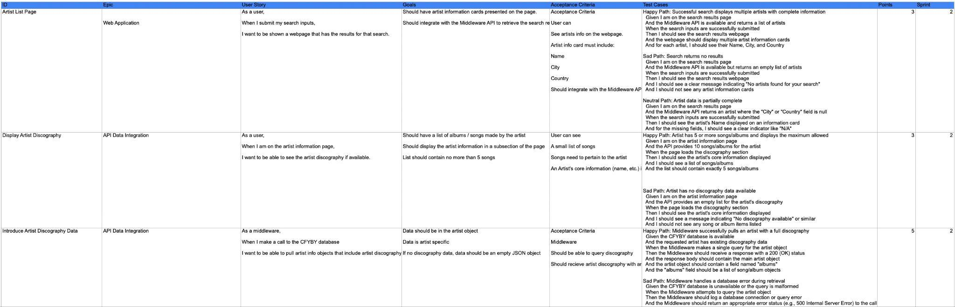
User Stories / Test Cases

Slide 23
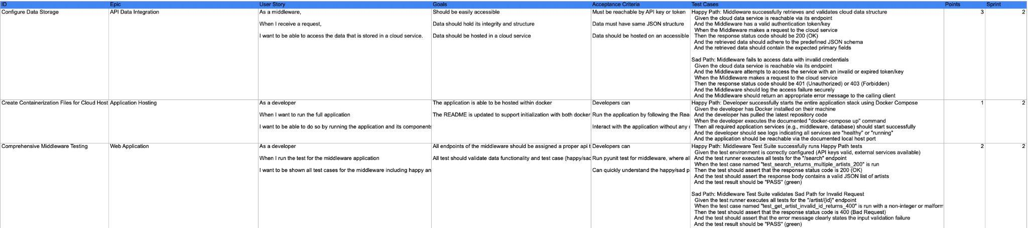
User Stories / Test Cases

Slide 24
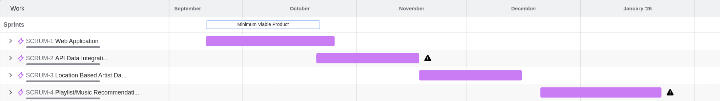
Project Schedule
Sprint 0 : September 2 - September 22
Sprint 1 : September 23 - October 20
Sprint 2 : October 21 - November 17
Sprint 3 : Completion of MVP: November 18 - December 15
Weekly Meetings: Tuesdays at 6:00PM

Slide 25
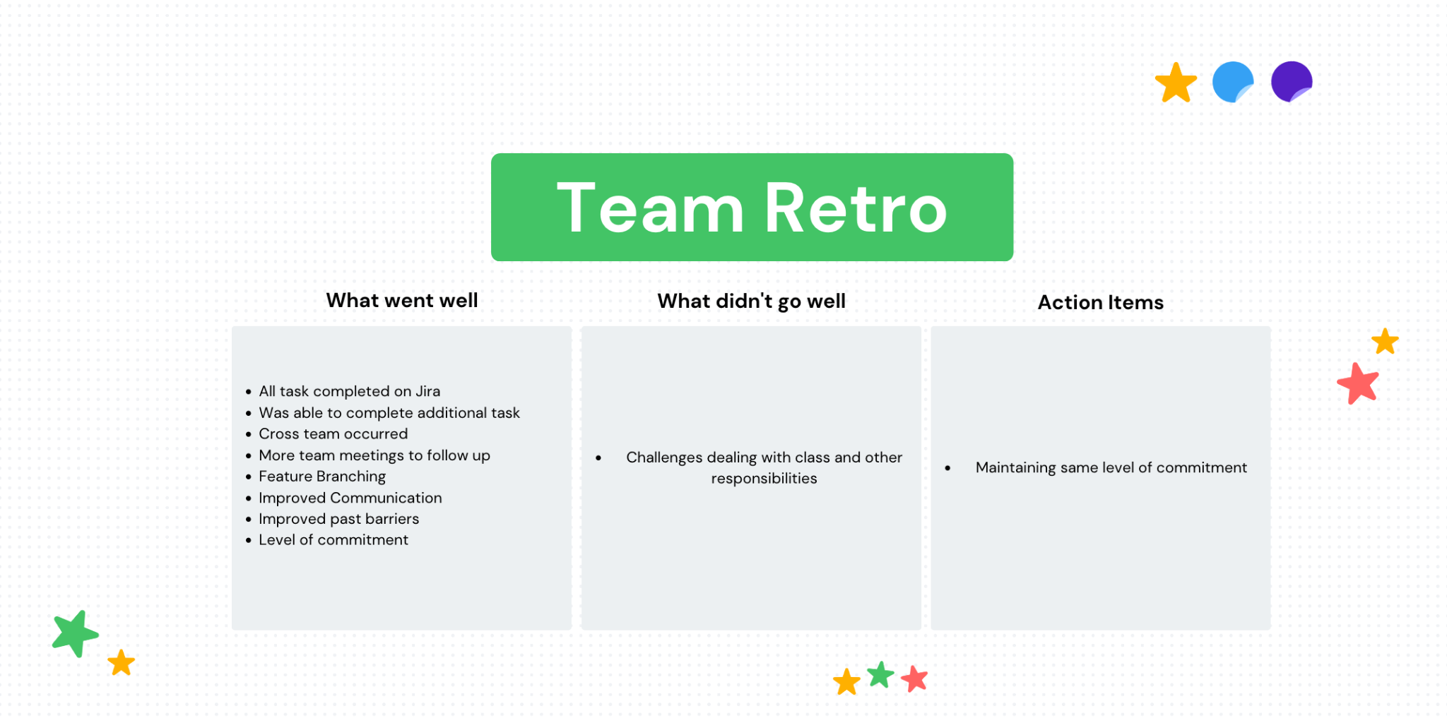
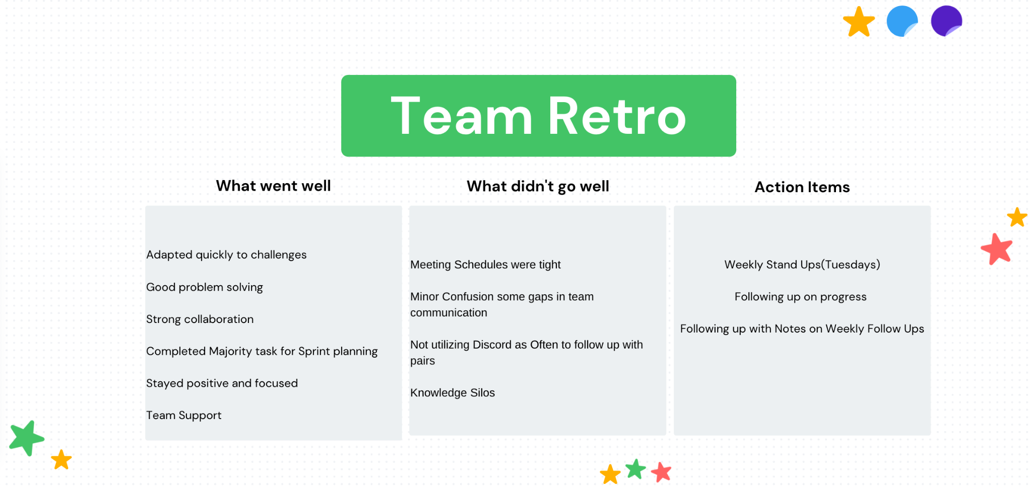
Retrospective

Slide 26
AI Disclosure
These AI Tools were used to aid us in brainstorming and project development:
Gemini CLI
ChatGPT

Slide 27
Thank You!
Wiki Page/Github Repo: https://github.com/htmw/F2025-Async/wiki

